Slide 1


01
Development Backgrounds
Before starting our presentation
TABLE OF
CONTENTS
02
How Does It Works
What it will do
03
Key Features & Benefits
It’s awesome features
04
Application Case Study
Netflix new ideas & Implementations
05
Study Comments
Data Ingestion: Kafka
Our comments after the study
06
Reference(s)
Source references of entire topics

Slide 2

Development Backgrounds 6 Ws
1
Who/Owner(s)
2
When
3
Why
Developed by LinkedIn (Jay Kneps).
On GitHub in late 2010.
Accepted as an Apache software foundation incubator project in July of 2011.
Apache kafka graduated from the incubator of 2012.
To get data from source systems and reliably moving it around.
Jay Kreps chose to name the software after the author Franz Kafka because it is "a system optimized for writing", and he liked Kafka's work.
4
Where
5
Abstract
6
How
The development team at LinkedIn.
Apache Kafka is a framework implementation of a software bus using stream-processing.
It is an open-source software platform developed by the Apache Software Foundation written in Scala and Java.

Slide 3

SINCE…
2
0
1
0
Today, Kafka is used by thousands of companies including over 60% of the Fortune 100.

Slide 4
How Does It Work
Architecture of Kafka
Zookeeper
Producer
Kafka cluster
Kafka broker 1
Kafka broker 2
Topic 1
Topic 1
Topic 2
Topic 2
Subscriber

Slide 5

Producer Record
Topic
(Partition)
(Key)
If fail on retry, throw exception
Value
Serializer
If success, return
information
Partitioner
Retry?
Yes
Topic A Partition 1
Topic A Partition 1
Batch 1
Batch 1
Yes
Batch 2
Batch 2
Fail?
Batch 3
Batch 3
No
Kafka Broker
Algorithm

Slide 10
Transaction Coordinator
Topic 1
10) success
Transaction Log
1) Register
Topic 1
Init
2) Bump epoch
3) Add partitions to transaction
6) Commit transaction
ongoing
4) Add partitions
Producer
5) Send msg to partitions
Topic 1
Prepare
7) prepare
Committed
9) Committed
Workflow

Slide 11
Kafka Ecosystem
Topics
1)
VERTICAL TIMELINE
A Topic is a category/feed name to which records are stored and published. As said before, all Kafka records are organized into topics.
Messages
2)
A messaging system sends messages between processes, applications, and servers.
Partitions
3)
Partitions are the main concurrency mechanism in Kafka. A topic is divided into 1 or more partitions, enabling producer and consumer loads to be scaled.
Brokers
4)
A Kafka broker allows consumers to fetch messages by topic, partition and offset. Kafka brokers can create a Kafka cluster by sharing information between each other directly or indirectly using Zookeeper.

Slide 12
Controllers
5)
In a Kafka cluster, one of the brokers serves as the controller, which is responsible for managing the states of partitions and replicas and for performing administrative tasks like reassigning partitions.
Zookeeper
6)
ZooKeeper is used in distributed systems for service synchronization and as a naming registry.
Producers
7)
Kafka producers are the publishers responsible for writing records to topics. Typically, this means writing a program using the producer API available in your chosen client library.
Consumers
8)
Kafka consumers are the subscribers responsible for reading records from one or more topics and one or more partitions of a topic.

Slide 13
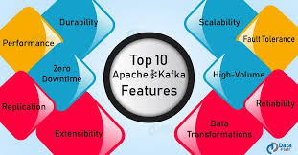
Apache Kafka features
Scalability
5 Features
High-Volume
Data Transformations
Fault Tolerance
Replication

Slide 14
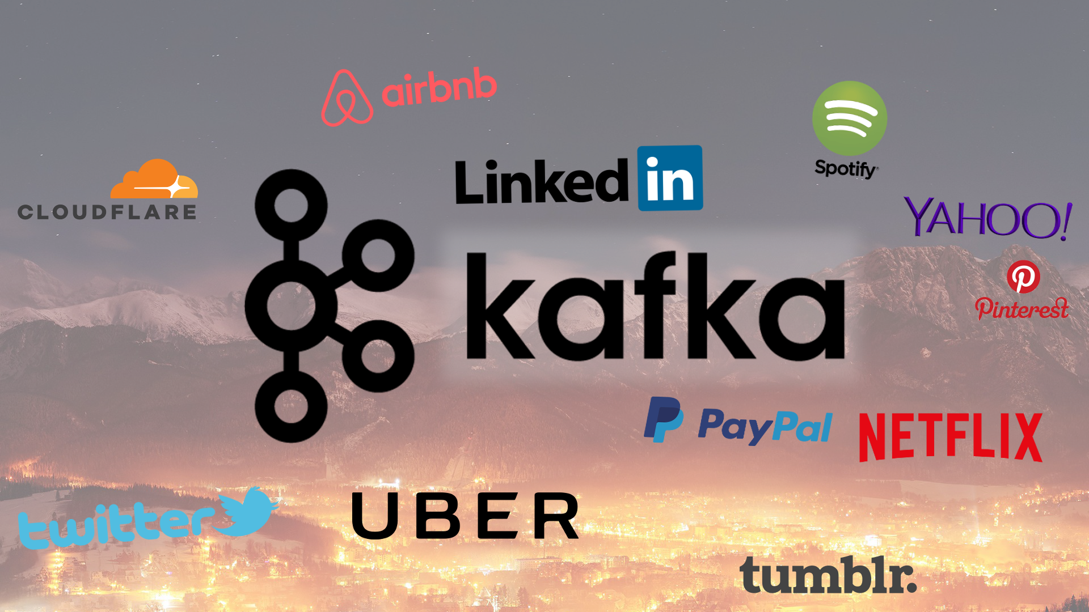
Apache Kafka benefits
Durability
5 Benefits
Performance
Zero downtime
Extensibility
Reliability

Slide 15

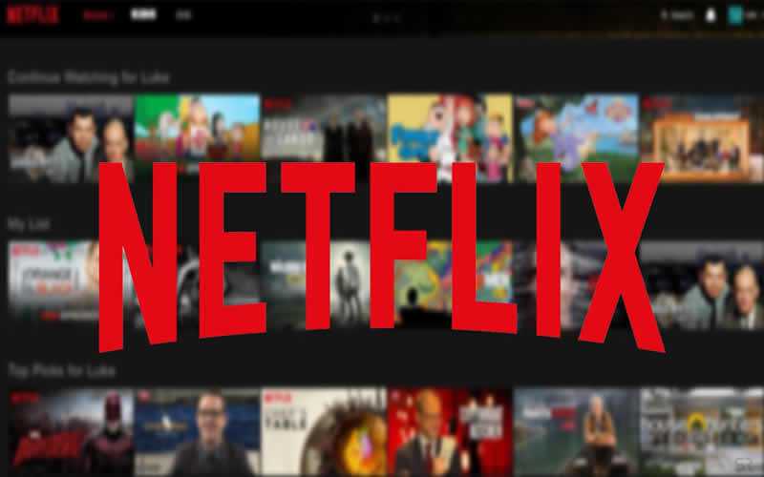
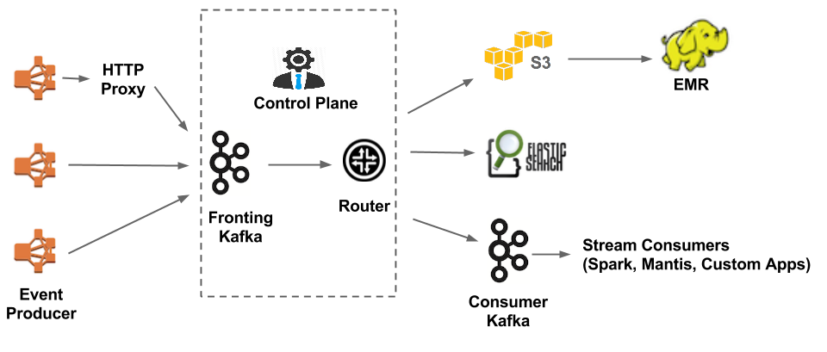
Application Case Study
Netflix

Slide 16
Evolution of the Netflix Data Pipeline
NUMERIC LIST WITH 3 ITEMS
V2.0 Keystone pipeline (Kafka fronted)
Chukwa collects events and writes them to S3 in Hadoop sequence file format. The Big Data Platform team further processes those S3 files and writes to Hive in Parquet format. End-to-end latency is up to 10 minutes.
V1.5 Chukwa pipeline with real-time branch
In V1.5, approximately 30% of the events are branched to the real-time pipeline. The centerpiece of the real-time branch is the router. It is responsible for routing data from Kafka to the various sinks: Elasticsearch or secondary Kafka.
V1.0 Chukwa pipeline
In addition to the issues related to routing service, there are other motivations for us to revamp their data pipeline. There are three major components, Data Ingestion, Data Buffering, Data Routing.

Slide 17
Design Principles of Netflix
They currently operate 36 Kafka clusters consisting of 4,000+ broker instances for both Fronting Kafka and Consumer Kafka. More than 700 billion messages are ingested on an average day. We are currently transitioning from Kafka version 0.8.2.1 to 0.9.0.1.
The Keystone pipeline produces messages asynchronously without blocking applications. In case a message cannot be delivered after retries, it will be dropped by the producer to ensure the availability of the application and good user experience. This is why they have chosen the following configuration for our producer and broker:
acks = 1
block.on.buffer.full = false
unclean.leader.election.enable = true
Most of the applications in Netflix use their Java client library to produce to Keystone pipeline. On each instance of those applications, there are multiple Kafka producers, with each producing to a Fronting Kafka cluster for sink level isolation.
The producers have flexible topic routing and sink configuration which are driven via dynamic configuration that can be changed at runtime without having to restart the application process.
This makes it possible for things like redirecting traffic and migrating topics across Kafka clusters.
For non-Java applications, they can choose to send events to Keystone REST endpoints which relay messages to fronting Kafka clusters.

Slide 18
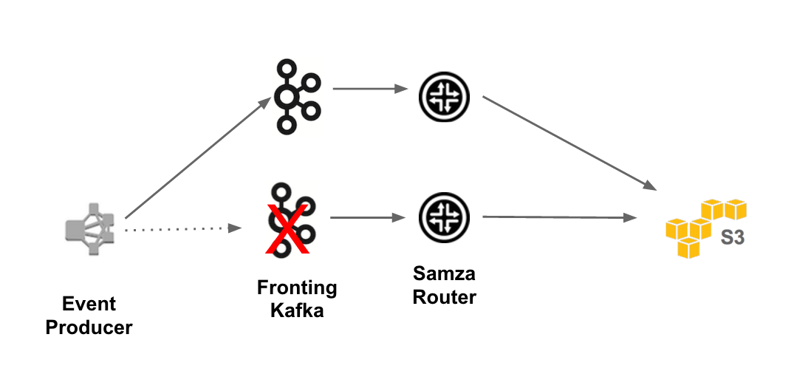
Kafka Development Strategy in Netflix
The following are the key strategies we used for deploying Kafka clusters
Favor multiple small Kafka clusters as opposed to one giant cluster. This reduces the operational complexity for each cluster. Their largest cluster has less than 200 brokers.
Limit the number of partitions in each cluster. Each cluster has less than 10,000 partitions. This improves the availability and reduces the latency for requests/responses that are bound to the number of partitions.
Strive for even distribution of replicas for each topic. Even workload is easier for capacity planning and detection of outliers.
Use dedicated ZooKeeper cluster for each Kafka cluster to reduce the impact of ZooKeeper issues.
The following table shows our deployment configurations:
Kafka Failover
 | Fronting Kafka Clusters | Consumer Kafka Clusters
Number of clusters | 24 | 12
Total number of instances | 3,000+ | 900+
Instant type | d2.xl | i2.2xl
Replication factor | 2 | 2
Retention period | 8 to 24 hours | 2 to 4 hours
Kafka Development Strategy

Slide 19
Development of Kafka
5 DEVELOPMENTS AND DESCRIPTIONS
Producer sticky partitioner
It sticks to a certain partition for producing for a configurable amount of time before randomly choosing the next partition.
Rack aware replica assignment
To ensure availability in case one zone goes down, they developed the rack (zone) aware replica assignment so that replicas for the same topic are assigned to different zones.
Kafka metadata visualizer
Kafka’s metadata is stored in ZooKeeper. We created our own UI to visualize the metadata. It provides both chart and tabular views and uses rich color schemes to indicate ISR state.
Monitoring
They created a dedicated monitoring service for Kafka. It is responsible for tracking such as, Broker status, Broker ability etc.
Future plan
They are currently in process of migrating to Kafka 0.9, which has quite a few features we want to use including new consumer APIs, producer message timeout and quotas.

Slide 20
Study Comments
Our abstract/evaluation (Apache Kafka)
The evaluation from our side is, when we were collecting the data's little collapsed. Eventually, from our understanding it’s a “A distributed streaming message platform (or) Event processing platform”.
Impact for us from the study and understanding
After the case study of Netflix , we learned what kind of vital role the Big Data playing in the world. It’s enormous really unshakable one in the future of the world.
The better alternative technology for Kafka
One of the best alternative technology is “RabbitMQ”.
How the time stamps working in Kafka ?
We still have a doubt how the time stamps working in Kafka.

Slide 21
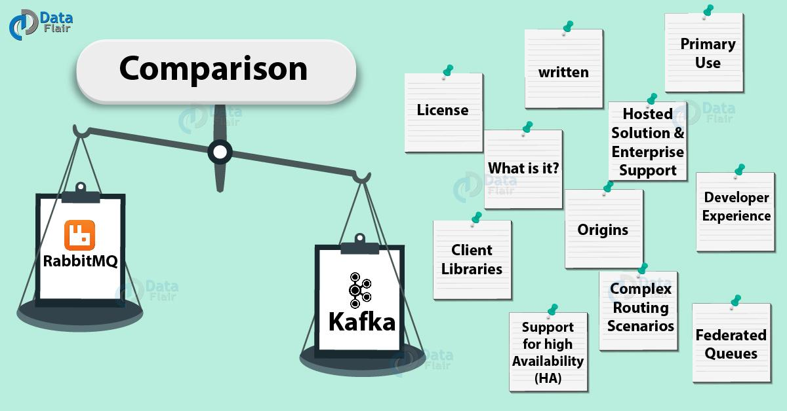

Slide 22
Reference(s)
Neha Narkhede, Gawan Shapira & Todd Palino, “Kafka The Definitive Guide,” O’REILLY, 2017, https://www.oreilly.com/catalog/errata.csp?isbn=9781491936160 .
https://kafka.apache.org/intro .
https://netflixtechblog.com/evolution-of-the-netflix-data-pipeline-da246ca36905 .
https://netflixtechblog.com/kafka-inside-keystone-pipeline-dd5aeabaf6bb .
https://en.wikipedia.org/wiki/Apache_Kafka .
https://en.wikipedia.org/wiki/Franz_Kafka .
https://www.instaclustr.com/a-visual-understanding-to-ensuring-your-kafka-data-is-literally-in-order/ .
https://data-flair.training/blogs/kafka-vs-rabbitmq/ .

